Slide 1
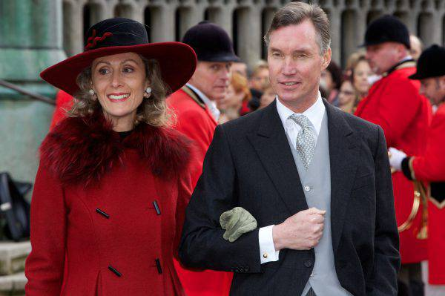
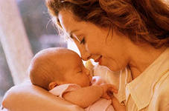
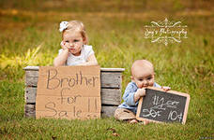
Цифровая книга
Бакина О.Н.
г. Рославль
2020
Mother
Sister
Brother
Aunt
Uncle
Grandmother
Grandfather
Father
Family
Family words

